Slide 1


Capstone Project
EDA on Airbnb booking
By
Chetan Prakash

Slide 2
Problem Statement :-
For this project we are analyzing Airbnb’s New York City(NYC) data of 2019. NYC is not only the most famous city in the world but also top global destination for visitors drawn to its museums, entertainment, restaurants and commerce.
Our main objective is to find out the key metrics that influence the listing of properties on the platform. For this, we will explore and visualize the dataset from Airbnb in NYC using basic exploratory data analysis (EDA) techniques.
Data analysis on thousands of listings provided through Airbnb is a crucial factor for the company.
We will be finding out the distribution of every Airbnb listing based on their location, including their price range, room type, listing name, and other related factors.

Slide 3
Data specification :-
There are total 48895 rows and 16 columns.
List of Columns :-
Id
Name
Host_id
Host_name
Neighbourhood_group
Neighbourhood
Latitude
Longitude
Room_type
Price
Minimum_neights
Number_of_reviews
Last_review
Reviews_per_month
Calculated_host_listing_count
availability_365

Slide 4
Agenda :-
We try to answer following questions for Airbnb:
How many hotels are available for 365 days and top 5 hotels name?
Is the Manhattan neighbourhood preferred over other neighbourhood?
For each neighbourhood count how many of them prefer the same location?
Best rating hotels according to their price?
Minimum neights people should pay per hotels?
Most busiest hotel and why?

Slide 5
Agenda :-
Distribution of listing across the neighbourhood?
Grouping neighbourhood according to their location with pricing?
Most demanding Host for airbnb?
Which area get highest number of reviews?
Correlation between all the data?

Slide 6

Map of New York City :-

Slide 7
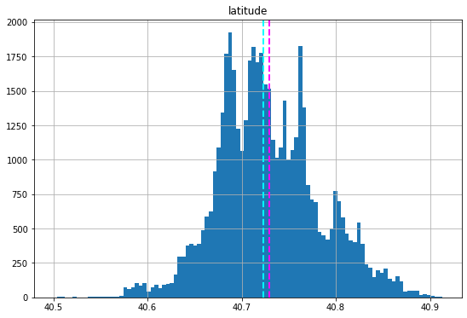
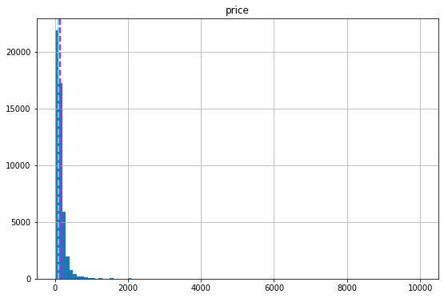
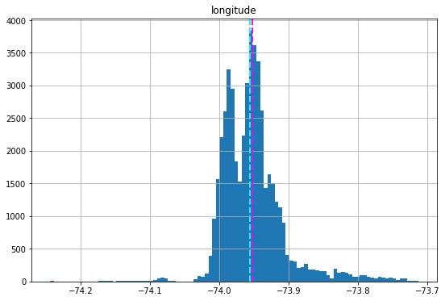
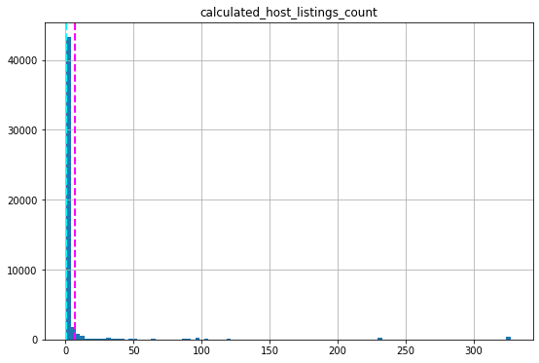
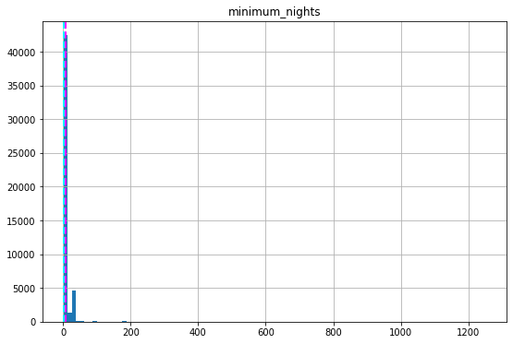
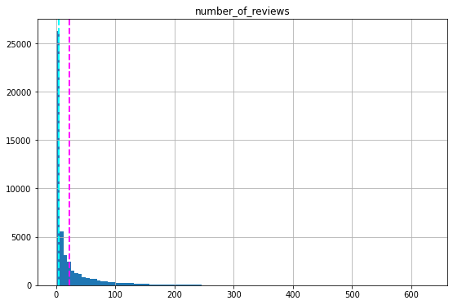
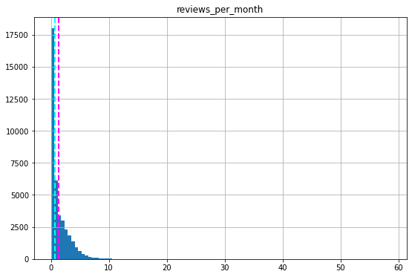
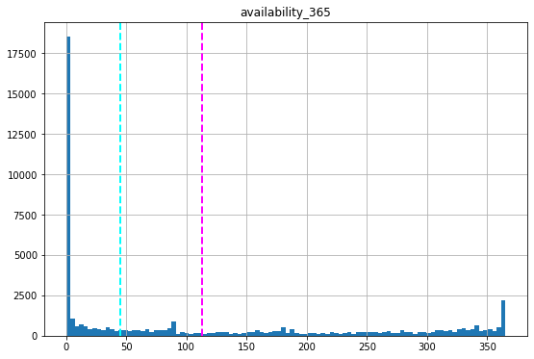
Mean and median value of all the numerical value

Slide 8
How many hotels available for 365 days :-
As we see according to our dataset and our analysis that most of the people preferred Entire home/apartment(25409) compare to private room(22326) or shared room(1160).
And as we talk about availability 365 days total number of location available are 1294.
And top 5 locations are “Clean and quiet apt home by the park”, ”The village of Harlem”. “Clean and quite in Brooklyn”, “Country space in the city” and “Upper Manhattan”.

Slide 9
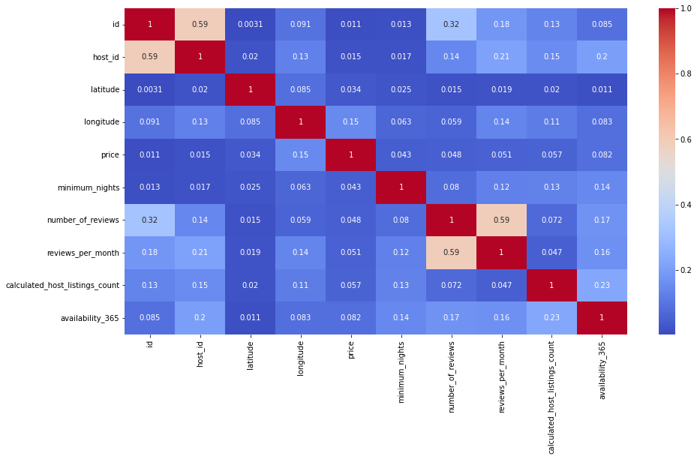
Correlation between all the numerical data
As we can see from this chart that there are not that much correlation between given category because the maximum value here we found is 0.32 between Host_id and number_of_reviews and some more correlation between host_listing_count to availability_365.

Slide 10
Is the Manhattan neighbourhood preferred over other neighbourhood :-
As we can see through our analysis that people prefer more Manhattan neighbourhood location compares to other location.
Manhattan 21661
Brooklyn 20104
Queens 5666
Bronx 1091
Staten Island 373

Slide 11
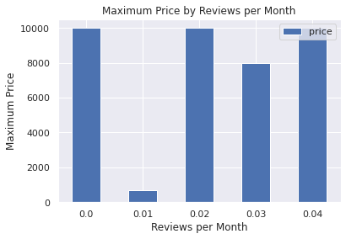
Best rating hotel according to their price :-
As we can see from this analysis that generally people reviews those hotel who have less price.
From 1st bar that price is around 1000 whose reviews is 0 and at 3rd bar price is again around 1000 rupees whose reviews is 0.02.

Slide 12
For each neighbourhood count how many of them prefer the same location :-
Index | host_name | neighbourhood_group | calculated_host_listing_count
13217 | Sonder(NYC) | Manhattan | 327
1834 | Blueground | Manhattan | 232
1833 | Blueground | Brooklyn | 232
7275 | Kara | Manhattan | 121
7480 | Kazuya | Queens | 103

Slide 13
Minimum neights people should pay per location acc to price :-
Index | Minimum_neights | Name | Price
0 | 1 | null | 327
1 | 1 | !Amazing private room 2 min from train station | 232
2 | 1 | Borough border liner | 232
3 | 1 | Cabin-private queen bedroom | 121
4 | 1 | Desirable deal on the park | 103

Slide 14
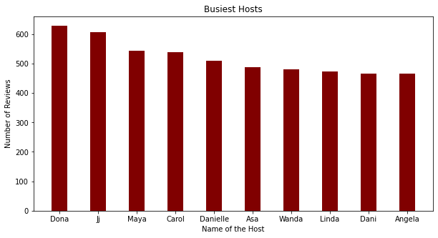
Most busiest location and why :-
As we can see that Dona, Jj, Maya, Carol, Danielle is the most top 5 busiest host.
According to chart highest whose reviews is maximum people choose them more.
So we try to make each and every review should be good so that’s helps in our business.

Slide 15
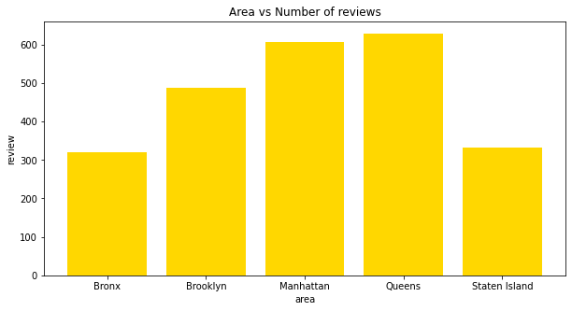
Area have highest number of reviews :-
As we see highest number of reviews get Queens area which is 629.
So if the number if reviews is highest people visit them most.
In these top 10 Angela is the lowest one so we have to improve it.

Slide 16
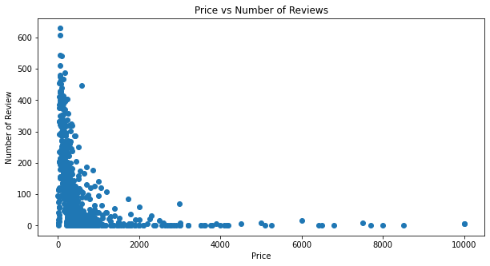
Price of host according to their number of reviews :-
So we already seen that generally price is low where people review and here people highest reviews means generally price is less in Queens locations.

Slide 17
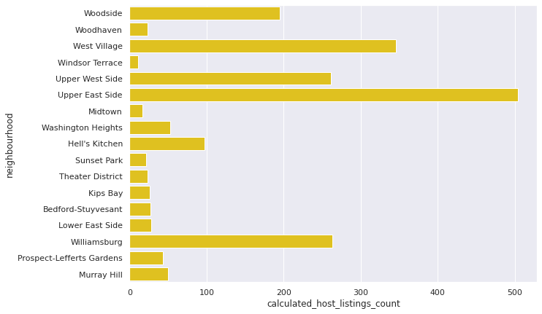
Distribution of listings across the neighbourhood :-
With this chart we can say that most of the listings are located in Upper East Side.
So we have to check why Upper East Side is most listed and why others are not and make changes according to it.

Slide 18
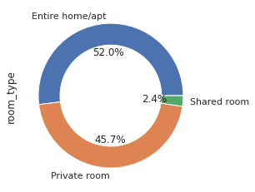
Room type distribution :-
We already know that mostly people choose Entire home/apt and according to it the availability of room type is seen.

Slide 19
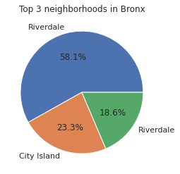
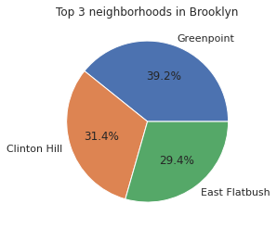
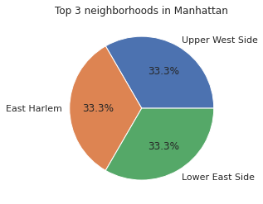
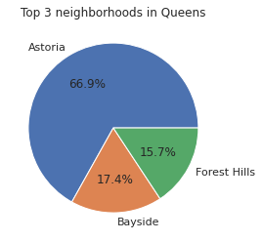
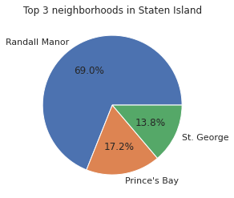
Grouping neighbour according to location :-

Slide 20
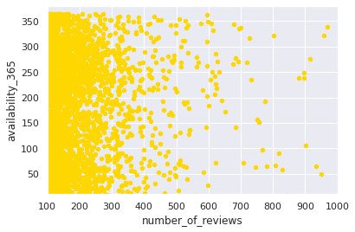
Most demanding host for Airbnb :-
The most demanding host is Gurpreet Singh whose number of review is highest that is 1157, Michael with number of reviews 732, Deloris with 693 and so on.
So these are the popular or premium host.

Slide 21
Challenges Faced :-
Reading the dataset and understand the meaning of some columns.
For answering some of the question we had to understand the business model of airbnb.
Handling the null values.
Design multiple visualization to summarize the information into the dataset and successfully communicate the result and trends to the reader.

Slide 22
Points which help Airbnb into their business :-
Manhattan is the most focused place in NYC for host do their business.
Customer pay highest amount in Brooklyn, Queens and Manhattan (i.e. $10000 -$10).
For the three types of room(Entire home/apt, private room and shared room) avg price is highest for Entire home/apt is 211.79, Private room is 89.78 and sharing room is 70.12.
There are total 1294 location who available for 365 days this information help to find people location where they can go anytime.
Then we see how best rating hotels according to their price this will help in business in improvement point of view that how we can improve so our rating, reviews, listing count will increase.

Slide 23
Some more points :-
And we see mostly people review those host who have less price so those host who don’t get enough reviews because may their price is too high make them less.
Upper East Side part having maximum number of list count
People choose Entire home/apt generally like so we have 52% of it, Private room 45.7% and Shared room 2.4 % so we have give more focus on Entire home/apt option so our profit will increase.
And we have to appreciate our premium customers like Gurpreet Singh
And we also check from group pie chart that which host doing well in a particular location.

Slide 24
Thank You

